Slide 1

INTRO // 01
Predictive Credit Analytics
Advanced delinquency forecasting and risk mitigation strategies using Machine Learning to safeguard loan portfolios and optimize collections.

Slide 2






FRAMEWORK // 02
Strategic Decision Flow
Customer Data
Decisioning
Strategic Action
Continuous Learning
Aggregating demographics, utilization rates, and historical behavioral markers.
Leveraging Logistic Regression to quantify risk probability per account.
Deploying targeted interventions and proactive limit adjustments.
Tracking repayment outcomes to refine and tune model accuracy.

Slide 3
GOVERNANCE // 03
Automation vs. Oversight
Autonomous Systems | Human Oversight
Real-time Risk Scoring: Instant calculation of default probabilities. | Complex Case Adjudication: Manual review for edge cases.
Pattern ID: Flagging utilization spikes automatically. | Compliance Audits: Identifying and mitigating algorithmic bias.
Automated Alerts: Triggering proactive SMS/Email reminders. | Hardship Negotiation: Personalized debt restructuring.
High-Speed Ingest: Processing millions of behavioral markers. | Strategic Policy: Setting global risk appetite and limits.

Slide 4


ETHICS // 04
Responsible AI Guardrails
Bias & Fairness Monitoring Auditing outputs to ensure neutrality across Age and Employment status.
Explainable AI (XAI) Clear feature-level explanations for risk scores for all stakeholders.
Data Privacy Strict encryption protocols for sensitive financial transaction history.
Model Auditing Tracking prediction drift versus real-world performance over time.

Slide 5



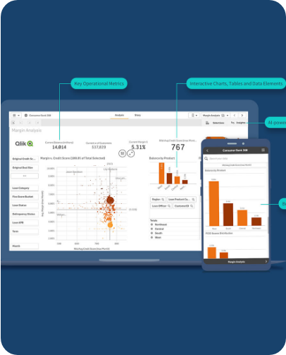
IMPACT // 05
Business & Customer Value
Business Success KPIs
Positive Customer Outcomes
• 15% Reduction in overall Delinquency • 20% Cost savings in Operations • Improved DSO Velocity • Minimal Net Charge-off rate
• Higher CSAT via respectful contact • Improved credit health transparency • High hardship recovery success • Avoidance of permanent defaults

Slide 6





STRATEGY // 06
Strategic Impact on Geldium
Operational Scalability
The system adapts to high-volume growth without linear headcount increases, allowing for dynamic strategy pivots.
Enhanced Trust
Personalized empathy-first messaging increases "Promise-to-Pay" adherence and strengthens brand loyalty.

